Slide 1
Infant Mental Health; Growing the roots and shoots of emotional wellbeing
Dr Helen Stevens
Clinical Psychologist & Clinical Lead –
Bury Early Attachment service

Slide 2
Be aware & compassionate to yourself
We have all been babies and have relationships with caregivers and some of us will also be parents
Take care of yourselves and treat yourself and others with compassion.
Remember that all parents do the best they can at the time, sometimes under very difficult circumstances.
This is a complex subject and this will just be a whistle-stop tour!
Notes:
You will probably think about your own experiences.
We have all been infants
We all will know or work with pregnant and young families
The Infant becomes the child, becomes the adult mental health
We all have an investment in this

Slide 3
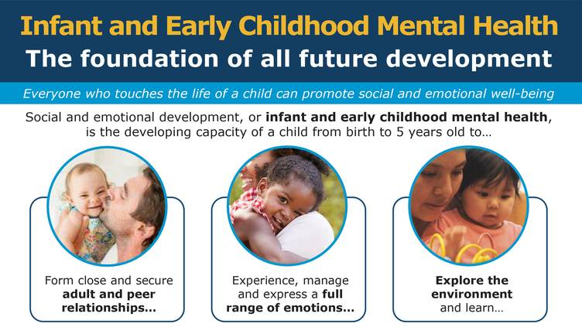
What is Infant Mental Health
Notes:
0-3

Slide 4
Baby’s brains
When can a baby recognise a human face?
From Birth
1 week old
1 month old
How many connections are made every second in a baby’s brain?
5 hundred
1 thousand
50 thousand
1 million
Notes:
We are hard wired for relationship s and the brain is responsive to experiences.
1 million every second!

Slide 5
Growing an Emotional Brain

Slide 6
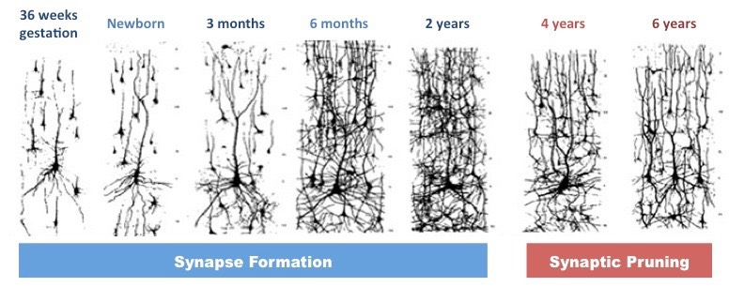
Brain development and pruning
Notes:
Birth – potential only – all the brain cells you need but none of the connections
You can see the rapid growth in the first 2 years
At 2 years - loads of connections, indiscriminate, jack of all trades, master of none.
By 4 – pruning – connections that aren't used die away – help increase brain efficiency and specificity
6

Slide 7
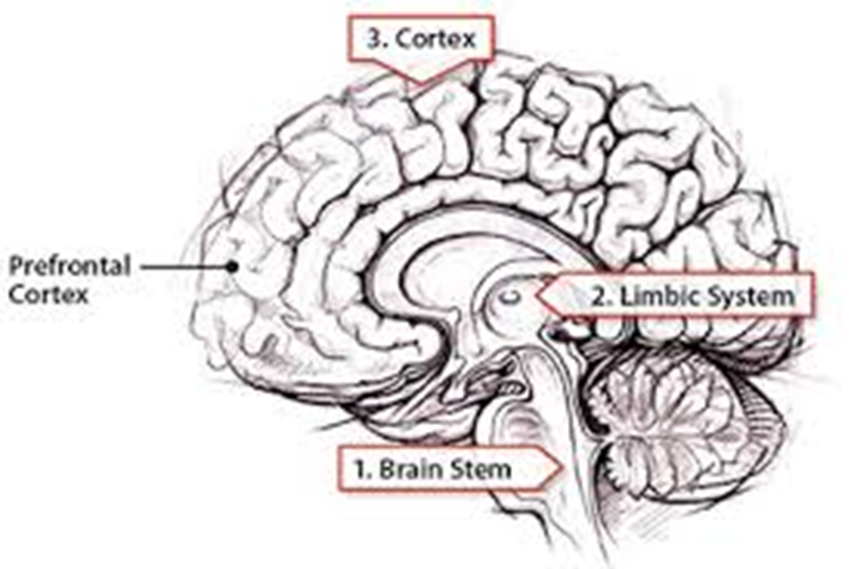
Brain development
User-dependent – ‘Whatever fires together, wires together’
Critical periods – ‘use it or lose it’
Hierarchical
Development is impacted by body’s stress response
Notes:
Develops in sequence starting with the most primitive parts of the brain (startle response)
https://www.youtube.com/watch?v=hVN0YzBVAKQ
Brain physically and functionally changes
PF cortex – rational thought and emotional regulation and social brain – less capacity for self control and pause and reflect on feelings. – impact on lives and relationships.
Dev in social context
Use dependant – perry
Pruning occurs – unused pathways to improve efficiency
PFrontal cortex –
Big role in social interaction plus platform to reflect on emotions and exert control

Slide 8
Why the parent-infant relationship so important?
Parent Infant Foundation 2020

Slide 9
Notes:
Relationships Lay the foundation for lifelong mental and physical health and
Mean babies feel safe ad secure ready to play explore and learn
Mean I can enjoy and achieve at school and progress in the workforce
Enables me to understand and manage my]]my emotions and behaviour which means I can make a positive contribution
Gives me the skills to form trusting relationships and to be a nurturing parent myself

Slide 10
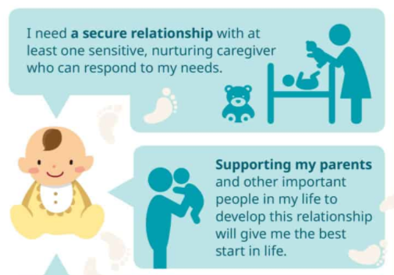
Notes:
Stress factors can make it harder for parents to provide sensitive care, e.g. MI, DA, poverty and unresolved dev trauma / Intergenerational patterns –
Anxious, tuned out or overwhelmed
Anything that either prevents or makes it more difficult for the parent to noticing or respond sensitively to the infant,
There are many reasons why you might find bonding with your baby difficult, either in pregnancy or during the first few years of life:
Loss and bereavement
Difficulties in pregnancy or a traumatic birth
Difficulties in relationships with our own parents
Difficulties with our mental health
Experiencing Domestic Abuse
When an Infant has health difficulties
Ideally there is as much attuned ‘serve and return’ interactions as possible,
Not perfect – good enough – around 50%
And a way of repairing and reconnecting when things go wrong.
Compassion for yourself as a parent

Slide 11
5 ways to Social & Emotional Wellbeing
Play
Watch
Time
Talk
Respond
Notes:
You don’t need to do too much to stimulate your baby’s brain but giving them cuddles and face-to-face contact is a great place to start.The most important thing is to enjoy being together.
How can you boost babies’ brain development?
In the early days of a baby’s life, their brain will be very stimulated and everything they see and do is a learning experience for them As Danielle says, “Young babies are naturally learning and there is a lot for them to take in. Just by being together and interacting with your little one, you will start to tune into each other and build familiar routines”.
You can start these interactions with your baby through:
Skin-to-skin contact, holding them and having cuddles
Being available and responding to them
Talking to them face to face throughout your day
Including them in conversations with those around you
Danielle says it’s important to remember that you don’t need to do anything extraordinary to boost your baby’s development. As they grow up, talking, cuddles and play can be built into your daily routine and can have long lasting positive effects on your child.
How to stimulate a baby’s brain
You don’t need to do too much to stimulate your baby’s brain but giving them cuddles and face-to-face contact is a great place to start.
Sometimes babies can become overstimulated if they are faced with music, lights and too much noise. Remember, they are learning a lot of new things from the moment they are born just by being in the world.
Your little one will begin to learn that your voice goes with your face and your smell. Early on in your child’s life, your baby’s vision is very limited but as they get older, they will be able to focus and tune into what you're doing. We have a collection of simple activities and things to do with children aged 0-3 months. Find some new ways to bond with your baby here.
The most important thing is to enjoy being together. Make sure that you are okay too - it can take a while to adjust to a new lifestyle, especially without much sleep.
Play – just face – ¾ months – moving onto joint attention
Watch - What are they interested in / like / feeling. Get to know them
Allow time – brain slower, they want to take part, need breaks – normal to look away
Talk – building language ability, your conversations build love
Respond to their communications – make them feel important and loved. A cry always means something – its their only way to tell you but it takes time to know at first you are working it out together.

Slide 12
What everyone can do to promote emotional wellbeing for infants
Validation and acceptance can be very therapeutic for parents who are struggling. It may not feel like much but listening to and containing the parent’s feeling will enable them to be more available for their baby.
Anything that helps the parent to tune in and pay attention and develop interest in the baby’s thoughts and feelings
Get help for parents and Infants at risk of difficulties in their relationships as soon as possible.
Notes:
Encourage the parent to look for their baby’s communication, think about their baby is thinking and feeling and to experiment with responding
Help parent’s observe baby’s behaviour and interpret what it means.
Encourage parent’s to talk to baby – tell them what they are doing e.g. when nappy changing
Ask parents what the baby is feeling? to help them tune into emotions
Position parent and baby face-to-face to support interactions
Encourage singing and reading to baby
Encourage parents to give the baby space to initiate interactions and to be aware when baby needs to look away
Encourage parents to mirror baby’s noises and facial expressions. Learn to take turns.
Help parents to see their babies communication and help them notice when they are doing it
How did baby come to be? Was pregnancy planned / unexpected / unwanted / was it an assisted pregnancy?
Experience of pregnancy - any complications? Sense of support
Previous pregnancies? Including terminations and miscarriages
Any significant loss? Including perinatal themselves of within the wider family or loss of own parents.
Experience of baby’s delivery and sense of support
How is mum recovering? Any complications?
Feelings about and towards baby
How are parents and baby getting to know each other?
Confidence as a parent
Sense of support from others
How is the parental relationship adapting?
Any significant experiences in own childhood and relationship with own parents.
How is baby’s health and development
How has baby’s feeding established – any issues e.g colic/ reflux? Any disappointments e.g. unable to breastfeed
How has the parents mental health been affected by becoming a parent?
Are there any aspects of being a parent which are more difficult and troublesome?

Slide 13
Where to get support for infants and their parents
Primary Care - GP, Midwife, Health Visitor
Children’s Centres & Early Help
Volunteer/Befriending services
Adult Mental Health – IAPT / Perinatal Mental Health Team
Women’s Aid /Independent Domestic Violence Advisor
Parent infant Mental Health Team – Early attachment service

Slide 14
Bury Early Attachment Service: Our Aims
Promote good parent infant relationships across the borough for all families
Support the early recognition of relational problems
Work effectively and efficiently as a part of an integrated Parent infant mental health pathway.
Advance the understanding of parent infant mental health and promote an Infant frame of mind.
Provide comprehensive assessment and evidenced
based interventions when needed

Slide 15
The 1001 Critical Days A Cross Party Manifesto (2013)
“Intervening more actively in the first 1001 days of a child’s life can improve children’s health, development and life chances and make society fairer and more prosperous.”
Notes:
There is a strong movement to recognise that babies cannot wait
The 1001 Critical Days Manifesto is a unique, cross-party manifesto setting out a vision for the provision of services in the UK for the period between conception and age 2 for the early years period.
The Manifesto was launched in 2013 and again in 2015. In launching the Manifesto, politicians from across the political spectrum came together to acknowledge the importance of the 1001 critical days, and pledged to give all babies the best possible start in life (when the brain is wiring up and the capacities that underpin emotional wellbeing are developed in the relational context.
Critical’ phase
james heckman – equation that details the the greater the investment – the greater the return
The effects of not intervening early are damaging not only for the child as they grow up, but also to society as a whole
Children's early experiences can have long-term impacts on their emotional and physical health, social development, education and future employment – which can lead to significant long-term costs to the public purse (Comptroller and Auditor General & Department for Education, 2014).
Rather than directing money into preventing problems occurring in the first place, we mostly spend money on costly 'late interventions' for children and families. In England and Wales, late intervention costs the state £17 billion a year. The costliest interventions are taking children into care, dealing with the consequences of domestic violence, and welfare benefits for 18-24-year-olds not in education, employment or training (Early Intervention Foundation, 2015).
Yet the research evidence is clear: intervening early to improve the mental health of young children is one of the most cost-effective ways of improving mental and physical health, and national productivity as a whole (Olds, et al, 1998; Stewart-Brown, et al, 2004; Heckman and Masterov, 2007).
Keeping the baby in mind not only aims to promote better health and outcomes for our future generation but it also makes financial sense.
Rigorous long term studies found a range of returns between £4 and £9 for every pound invested in early intervention for low income families.
navigate around missed neural opportunities and need to use compensatory educational /behavioural techniques, systemic support, justice and correctional systems, health and therapeutic interventions. This costs more.
The cost of perinatal mental health problems per year’s births in the UK was estimated in 2016 to be £8.9 billion a year
In 2016 The London School of economics and political science did a cost benefit analysis of the costs of perinatal mental health for mother and child and compared these with the cost of interventions to prevent and treat perinatal mental health in order to analyse if it is cost effective.
In brief they concluded it appears to be cost effective- in fact it was found to be 5 times cheaper to intervene with preventative and restorative treatments during the perinatal period than it is to stand back and have to respond to problems as they arise later on! This study included the following information of estimated predicted annual costs from the child to society should the mothers depression not be effectively treated. Briefly, costs included:
A range of public sector costs (health and social care, education, criminal justice)
Adverse child outcomes including pre-term birth, infant death, emotional and conduct problems, special educational needs, and leaving school without qualifications.
Health-related quality of life losses were calculated based on health impairments (measured in form of disabilities) experienced by children with cognitive, emotional or behavioural problems.
Productivity losses were calculated based on their reduced probability of leaving school with qualifications.
In 2017 A new researches analysis from Nobel laureate economist James J. Heckman et al found that high-quality interventions during early childhood have can prevent multiple generations of poverty. The Heckman equation was developed to explain this:
+ Invest
Invest in educational and developmental resources for disadvantaged families to provide equal access to successful early human development.
+ Develop
Nurture early development of cognitive and social skills in children from birth to age five.
+ Sustain
Sustain early development with effective education through to adulthood.
= Gain
Gain a more capable, productive and valuable workforce that pays dividends to America for generations to come.
For more information go to https://heckmanequation.org/

Slide 16
Notes:
These ideas aren’t new! Way back in the 19th century Fredrick Douglass an African American social reformist and Abolitionist famously said

Slide 17
Summary
Infants brains develop in context and in response to their experiences and the care they receive
Capacities for life long emotional wellbeing are developed in this period.
We need to Intervene early when there are barriers
Compassion is the key - All parents are doing their best.
Notes:
Good enough
Responsive relationships with consistent primary caregivers are the foundation of mental health across the life-course.

Slide 18
Where we are and how to contact us:
Bury Early Attachment Service
Healthy Young Minds
Fairfield General Hospital
Rochdale old Rd
Bury
BLP 7TD
Tel: 0161 716 1137
Email: Pcn-tr.buryearlyattachmentservice@nhs.net
Website: https://www.penninecare.nhs.uk/buryeas
Facebook Page: @buryEAS

