Slide 1
Building Resilience with Your Teens Dr Yehuda Marshall Clinical Psychologist

Slide 2
Adolescence
Thinking in a “new key”; development of abstract thought.
Challenge religious beliefs and authority.
Is this a crisis or opportunity?
Rebellion Vs forging independent sense of self and identity.
Cognitive changes: Sarcasm and challenge
Biggest influence on adolescent spirituality is parents (Pelcovitz et al, 2010)
Biggest influence on adolescent resilience is parents (Gottman, 1997)

Slide 3
Be an Emotional Coach (EC)
Good parenting requires more than good IQ (Gottman, 1997)
ECs accept negative emotions as a fact of life and use emotional moments as an opportunity rather than crisis.
Become aware of child’s emotions.
Recognise the emotion as being an opportunity for intimacy and education.
Listen empathically and validate the child’s feelings.
Help the child to find the words to label the emotion.
Set limits while exploring strategies to solve the problem at hand.
Notes:
Story of RHS and he kept upping the ante and getting into drugs.
Meeting with parents and they have a discussion about limits
Father lays down the law and loads many consequences.
Son gets ngry and Dr p asks parents to leave the room.
Waits till there out of earshot and calls Dr P over and whispers in his ear ‘it’s about time’

Slide 4
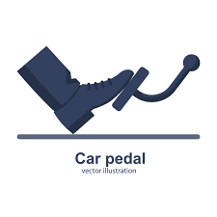
Love with Limits
Most parents want to treat their children with patience and respect.
“Family life is our first school for emotional learning” (Daniel Goleman)
Laisse-Faire Parenting (empathise, but fail to set limits)
Dismissive Parenting (disregard child’s emotion)
Disapproving Parenting (actively critical of child’s display of emotion
Push away with the left hand while you bring closer with the right hand (Talmud)
Notes:
Laisse-Faire Parenting (empathise, but fail to set limits) RHS –rules without relationships = rebellion
Dismissive Parenting (disregard child’s emotion) LHS
Disapproving Parenting (actively critical of child’s display of emotion LHS

Slide 5
Set Limits
Kol hamosif av yisrum al beno, mosif haben ahavah al aviv (Midrash)
Failure to set limits damages children.
Set limits calmly (avoid shutdown)
Be Rational (fits the ‘crime’)
Not too long (eyes on the prize)
Notes:
Story of RHS and he kept upping the ante and getting into drugs.
Meeting with parents and they have a discussion about limits
Father lays down the law and loads many consequences.
Son gets ngry and Dr p asks parents to leave the room.
Waits till there out of earshot and calls Dr P over and whispers in his ear ‘it’s about time’

Slide 6
Time!!
Families who eat together stay together (no mobiles!) (Columbia University)
Steal time with children (errands, shopping)
Rabbi Bloch from Telz Yeshiva
Kechitzim beyad giboy kein b’nei hanurim
Kotzker Rebbe: the closer the archer pulls the arrow to their heart the straighter and further it goes. So with our children, the closer we hold them to our heart the straighter and further they will go.
Mum will you get out of my life, but first will you take me and Sheryl to the mall?
Notes:
Rabbi Bloch, wake son at 6am and sit down and have tea together bfeore father went to davening and they would talk about previous and coming day

Slide 7
Developing Spirituality & Meaning
Model and discuss G-d being present in nature and our daily lives
Welcome questions no matter how controversial (Rabbi S. Wolbe,1999)
Do not bother your children when they are skateboarding (Peterson, 2018) – the power of a mistake
Prayer: Being a Tefilla Educator rather than Tefilla Teacher
- Empower teens to recognize their unique and unlimited potential to connect to G-d.
- Engage teens in taking part in the service at Shul
- Make the message of Prayer relevant to their lives (Drelich, 2016)
Notes:
Educator, derived from the Latin educat, means, “to bring out or develop something in potential.

Slide 8
Parents, Set Your Own House in Order
Develop an awareness of one’s own emotional development:
“Family life is our first school for emotional learning” (Daniel Goleman, 1995)
What pushes our buttons?
Invisible modeling - Subtle influence (Kahneman)
How honest are we? How do we treat others – Right hemisphere of the brain
Start to stop doing what you know to be wrong (Peterson, 2018)
Notes:
Educator, derived from the Latin educat, means, “to bring out or develop something in potential.

Slide 9
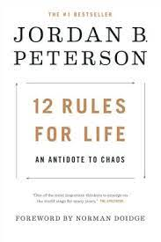
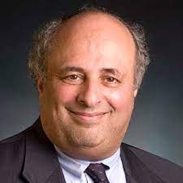
Resources

