Slide 1
Myths & Reality: Understanding Anxiety and Depression
By Tamar Tabor
Notes:
My name is Tamar Tabor.
I’ve worked in the NHS for over a decade now working with clients who have depression and anxiety disorders, so I am basing this talk on those conversations with the clients I have seen over the years.
Before I begin properly I just wanted to try something with everyone here – get everyone’s involvement for one moment.
Please can I have a show of hands from anyone in the room who has had a cold in the past few weeks – has anyone here had a cold?
Please can I now have a show of hands if anyone in the room has broken a bone before – an arm, a leg, a finger – show of hands from anyone here who has broken a bone.
Now… I am not asking for a show of hands – don’t put your hand up – but I want everyone here to IMAGINE what they would feel if I asked that anyone who has had depression or an anxiety disorder to put their hand up – how would you have felt about that? Would it have felt the same as the other two questions, or would you have felt some reluctance to put your hand up? Imagine if I asked everyone to put up their hand if they have a family member with depression or anxiety – would you be willing to put your hand up for that? How would it have made you feel to do that?
Whatever you have taken from that exercise… please just have that in mind when we now read about Miriam – Miriam is not a real person. She doesn’t exist. She’s a combination of many many many people.

Slide 2
Notes:
Miriam is 34 years old, married with 5 children and works in a local girls school.
When Miriam was growing up she often had to take care of her younger siblings as her mother was poorly and couldn’t get out of bed.
Miriam prides herself on being a capable “doer”. Someone who can “keep going” and cope in stressful situations – in fact she is the first person people come to when they need support or advice.
Miriam finds that in order to cope with stress she needs to plan ahead for every eventuality – “if I don’t… no one else will… and who knows what could go wrong?!”. She writes endless lists and lies awake at night thinking about what she might have missed and things that need attending to.
When Miriam gave birth to her 5th child she found herself feeling very tearful and low – she found it hard to bond with the baby and this made her feel even worse – she had never had this before. Everyone told her it was “baby blues” and it would pass.
Miriam usually loved being with her babies on maternity leave, but she was finding it so difficult she decided to go back to work earlier than usual in the hope that she would feel a bit more like herself again.
Work started off ok, but her colleague had to go off on sick leave and a lot more responsibility was put on Miriam’s shoulders. Miriam started feeling extremely anxious coming to school every day as she felt completely overwhelmed and out of control. Miriam started to feel short of breath, increased heart rate and dizzy in the classroom. She was worried that she would faint and embarrass herself in front her pupils and colleagues, especially when presenting to the class – something she used to really enjoy. Now Miriam does everything she can to avoid standing at the front of the class and gets her teaching assistants to do it for her.
Miriam finds that she is snapping and shouting more – in school and at home with her kids. She feels like she goes from 0 to 100 without any warning.
Miriam feels completely useless – she feels like a failure at home and a failure at school. She is too embarrassed to reach out to anyone as friends and family usually come to her – not the other way round, so Miriam has started to avoid picking up her phone and seeing people.
Miriam is feeling completely drained – she has no energy, nothing gives her any enjoyment or satisfaction anymore. Miriam has started to go to bed earlier and earlier as she just can’t keep going and hopes that if she can get enough rest she will have more energy and patience to deal with everything… but instead she finds herself lying in bed worrying and giving herself a hard time about everything she messed up that day.

Slide 3
Myths: It’s my fault I am a failure I should be able to snap out of it.
Notes:
I would say nearly all the people I see in therapy come with these sorts of myths. It is unfortunately such an inherent part of what makes mental health difficulties like depression and anxiety so tricky and keep them so stuck and feeling so shameful.
Miriam comes into therapy full of self-criticism and blame.
She believes that she has failed her baby, failed her children, failed her husband and her colleagues – feeling like a failure and that you have let others down is one of the key symptoms of depression.
Although Miriam would be the first person to say the complete opposite to friends of hers who are in the exact same position – Miriam finds it extremely difficult to turn this same way of thinking towards herself.
The reality of the situation is of course that having anxiety and depression is not her fault – it is not something anyone wants to bring on themselves, and if was so easy to “snap out of” people would do so. The reality is that depression and anxiety disorders develop due to a complex combination of factors.

Slide 4
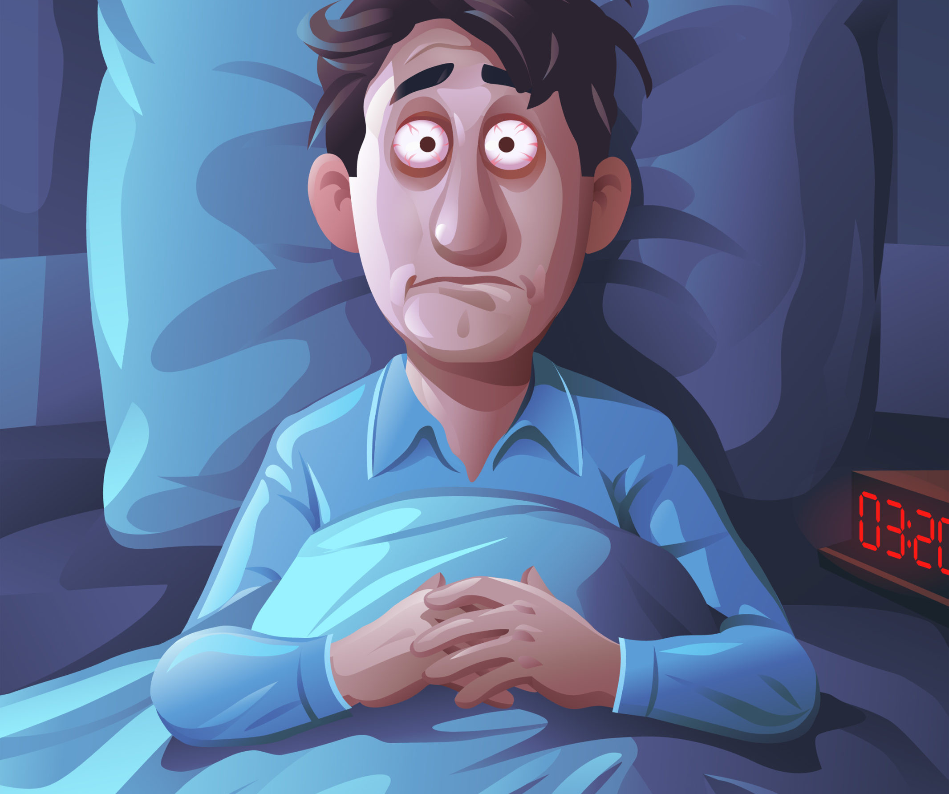
Notes:
There are of course so many complex factors involved in what might contribute to the development of depression or anxiety disorders.
Looking at Sarah there are a number factors that we can see – her genes will contribute, her hormones – post natal depression being heavily impacted on by hormones. Environmental factors – like the stressors in her life and also the environment she was brought up in, and throughout her life. As we’ve already touched on – thinking patterns contribute – negative thinking or thinking in a particularly catastrophic way – assuming that everything will go wrong. And then there are common behaviours which also contribute – particularly avoidance. All of these factors come together and can create an almost perfect storm when it comes to mental health. It is not Sarah’s fault and by no means makes her a failure.

Slide 5
Notes:
For anyone experiencing depression or anxiety the reality is that a multi dimensional approach often needed. It isn’t something you can just snap out. It requires a multi-faceted approach because it is a multi-faceted problem.
Sarah approached her GP and her GP put her in touch with a specialist health visitor that supports women experiencing post-natal depression and particularly helps with issues relating to bonding with her baby. Sarah is informed about medication and talking therapy so she can make an informed decision. Sarah begins talking therapy where she understands a lot more about the symptoms of anxiety and depression and why she is feeling so stuck and the steps that she can take to manage these symptoms and move forward, in a carefully guided, step by step approach.
Crucially, once Sarah starts to feel less self-critical, and less shame, she is able to start speaking to friends and family more openly and receive the support that she needs.

Slide 6
Notes:
For anyone here thinking about how some of these issues might be impacting them, please do consider reacing out to your own GP who is the most important first point of call for you.
Consider reaching out to a friend or family member that might be able to support you.
And remember that Neshomo as well as many other services are also there to support you confidentially and point you in the right direction

