Slide 1
A BRIEF INTRODUCTION TO PERSONALITY DISORDERS
Dr James Glass
MBChB MRCPsych

Slide 3
WHAT WE WILL COVER
01
02
03
04
BACKGROUND TO DIFFERENT TYPES
DIAGNOSIS OF
BORDERLINE TYPE
PSYCHOLOGICAL TREATMENTS
MEDICAL
TREATMENTS

Slide 4
01
BACKGROUND What is a Personality Disorder and why is it important?

Slide 5
PREVALENCE
There has been a significant increase in the number of cases of the past few years
> We don’t really know why…

Slide 6
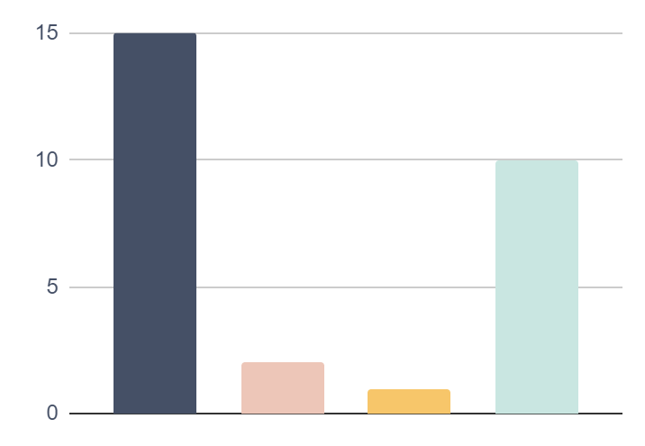
DEPRESSION VS EUPD
15%
2%
1%
10%
Depression Prevalence
Depression Suicide Rate
EUPD
Prevalence
EUPD
Suicide Rate

Slide 7
—RUPI KAUR
“I don’t know what living a balanced life feels like. When I am sad I don’t cry, I pour. When I am happy I don’t smile, I glow. When I am angry I don’t yell, I burn.”

Slide 8
CHARACTERISTICS OF PERSONALITY DISORDERS
SEVERE
GLOBAL ISSUE
So much that they intefere with normal life
Friendships, marriage, family and work
PERSISTENT
COMPLEX
Symptoms starting in adolesence
None can be cured with medication

Slide 9
MISCONCEPTIONS
MYTH
REALITY
There is something wrong with my personality and so there is something wrong with me
There is something going wrong that is affecting my personality

Slide 10
TYPES OF PERSONALITY DISORDERS
CLUSTER A
CLUSTER C
Odd or eccentric behaviours
Anxious or avoidant behaviours
CLUSTER B
Unpredictable behaviour and emotional instability

Slide 11
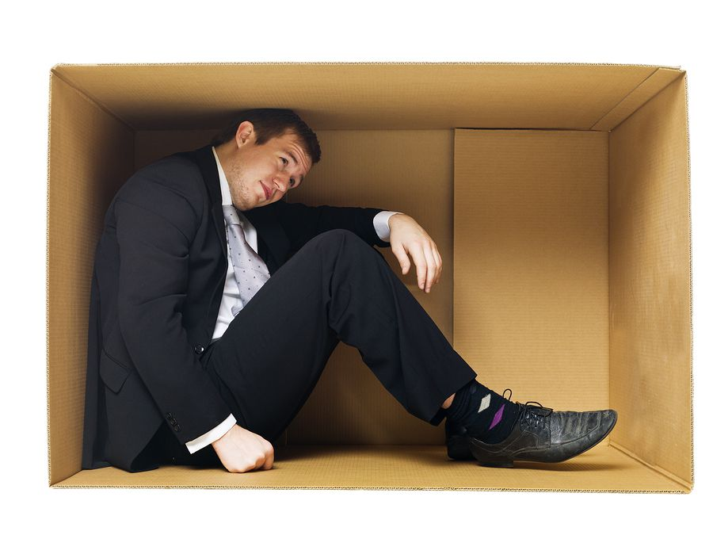
REMEMBER!

Slide 12
EUPD / BPD
Emotionally Unstable Personality Disorder
Borderline Personality Disorder

Slide 13
02
DIAGNOSIS What are the clinical features of Emotionally Unstable Personality Disorder?

Slide 14
SYMPTOMS OF EUPD
01
02
03
UNSTABLE EMOTIONS
UNSTABLE RELATIONSHIPS
UNSTABLE
SELF-IMAGE

Slide 15
SYMPTOMS OF EUPD
04
05
06
FEELINGS OF EMPTINESS
SELF-HARMING BEHAVIOURS
SUICIDAL THOUGHTS

Slide 16
SYMPTOMS OF EUPD
07
QUASI-PSYCHOTIC SYMPTOMS

Slide 17
NB:
Depression and anxiety are both commonly associated with EUPD

Slide 18
03
MANAGEMENT How to we treat Emotionally Unstable Personality Disorder?

Slide 20
TREATMENT IN REALITY
CHEST COMPRESSIONS
CHEST COMPRESSIONS
CHEST COMPRESSIONS
MEDICAL INTERVENTIONS

Slide 21
TREATMENT FOR EUPD
THERAPY
THERAPY
THERAPY
MEDICAL INTERVENTIONS

Slide 22
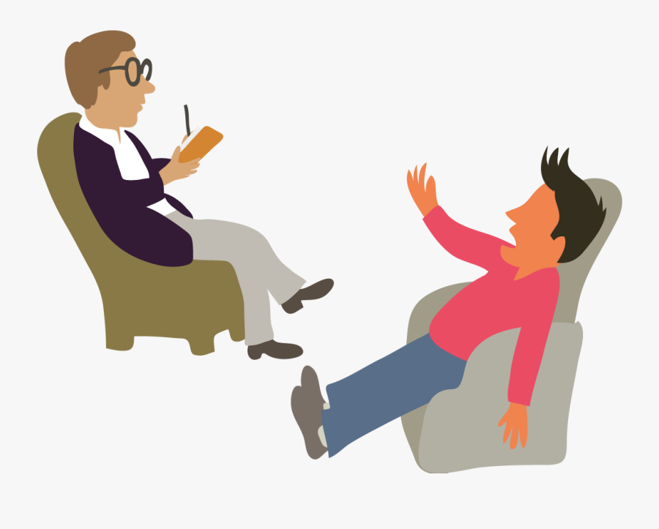
WHAT TYPE OF THERAPY?
Only trauma therapies!
e.g. DBT, MBT, CAT

Slide 23
—RUPI KAUR
“I don’t know what living a balanced life feels like. When I am sad I don’t cry, I pour. When I am happy I don’t smile, I glow. When I am angry I don’t yell, I burn.”

Slide 24
—RUPI KAUR
“I don’t know what living a balanced life feels like. When I am sad I don’t cry, I pour. When I am happy I don’t smile, I glow. When I am angry I don’t yell, I burn.”

Slide 26
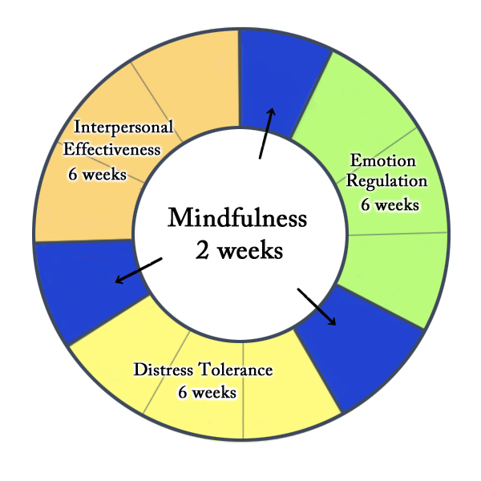
EMOTIONAL REGULATION
INTERPERSONAL EFFECTIVENESS
MINDFULNESS
DISTRESS
TOLERANCE

Slide 27
04
MEDICAL TREATMENT What is the role of medication for Personality Disorders?

Slide 28
MISCONCEPTIONS
IN THEORY
IN REALITY
Nil
A lot

Slide 29
ANTIDEPRESSANTS
MOOD STABILISERS
SEDATIVES
For depression or anxiety
For emotional instability
For distress and agitation

Slide 30
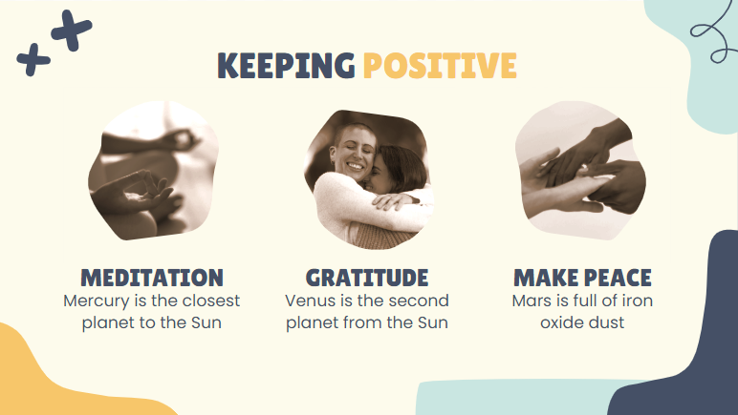
TRAUMA THERAPY + / - MEDICATION
TAKE HOME MESSAGE
If in doubt please contact one of your
local mental health organisations for advice

Slide 31
THANKS!
DO YOU HAVE ANY QUESTIONS?
admin@theinformedmind.co.uk
07761 312 049

